Slide 1


Development of MCQ System
Module Project
Module: Programming Foundations
Course: Applied Degree in Software Engineering
Start Date :
End Date :
Submission Date :
Learner Name
Enrollment ID
:
:
Wildan Luqmanul Hakim
STTB
Presentation Date :

Slide 2

Document History
Version Number | Effective Date of release | Summary of Included Changes | Author
1 | 1 Jul 21 | First Edition | Jeyashree
2

Slide 3
Contents
Project Definition
Project Deliverables
Project Milestones & Tasks
Project Environment
Tools
Project Design
Classes & Methods
Steps from Coding to Execution
Development Process
Coding Standards
Milestone Feedback & Action Taken
Project Results
Proposed Improvements

Slide 4
1. Project Definition
This project was created because the company wants to expand its market into the Information Technology subject areas. To assess their knowledge of the subject, the company wants their interns to create and produce software development. They want to learn how to use an MCQ system during the internship. The goal of this project is to create an MCQ system.
Proposed Solution
Taking user input from the console with Scanner
When the user answers correctly, use variable score and add the score.
Reading the CSV file using BufferedReader
Validating user input with an if-else statement and a loop

Slide 5
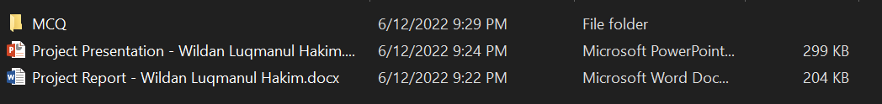
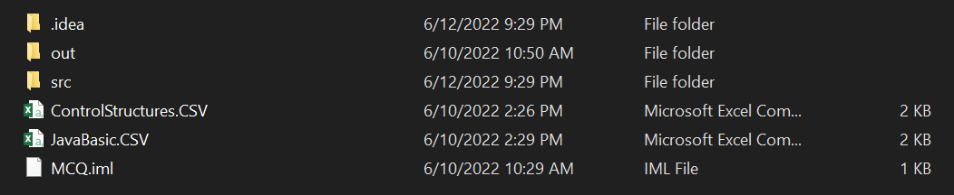
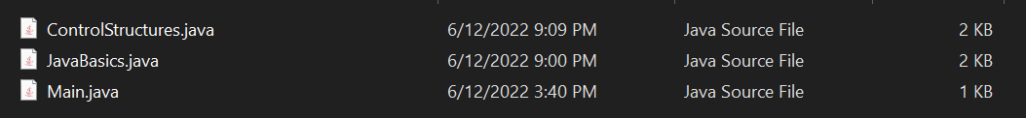
2. Project Deliverables
Project Deliverables
MCQ System
MCQ Set (CSV Files)
Project Report
Project Presentation
Source Code
List of Evidences

Slide 6
3. Project Milestones & Tasks
Project Task ID | Project Task Description | Project Milestone ID
1 | Create Requirement Specification | 1
2 | Develop Algorithm | 1
3 | Analysis and Design | 2
4 | Create the Application | 2
5 | Test the Application | 3

Slide 7
4. Project Environment
Technical Environment and Tools Used
IntelliJ IDEA
Microsoft Words
Microsoft PowerPoint
Microsoft Excel
Google Chrome
List of references
Github.com
Geeksforgeeks.com
Javapoint.com
Stackoverflow.com
Linkedin.com/learning
Quizizz.com

Slide 8




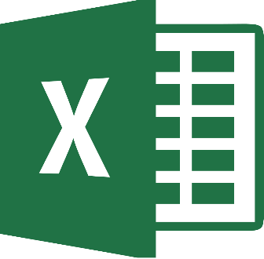
5. Tools
IntelliJ IDEA
Google Chrome
Microsoft Word
Microsoft PowerPoint
Microsoft Excel

Slide 9
6. Project Design
System Design

Slide 10
7. Classes & Methods
List of Classe
Main Class
JavaBasic Class
ControlStructures Class
List of Methods
main
run

Slide 11
8. Steps from Coding to Execution
Step 1 :
Write Questions and Answers Java Basic and Control Structures with csv format file
Step 2 :
Write the Java Code for Main, JavaBasic and JavaStructures
Step 3 :
Run The Program

Slide 12
9. Development Process
Understand the problem.
Use iterative and incremental programming.
Set aside blocks of time without interruption.
Use debugging techniques (assert, println, breakpoints).

Slide 13

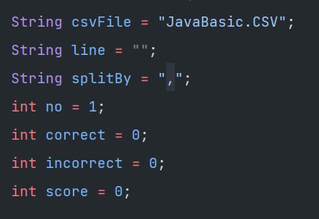

10. Coding Standards
Coding Standards for Classes
Coding Standards for Variables
Coding Standards for Methods

Slide 14
11. Milestone Feedback & Action taken
Poect Milestone ID | Milestone Feedback received from Tutor / Learning Facilitator | Action Taken (Yes / No)
1
2
3

Slide 15
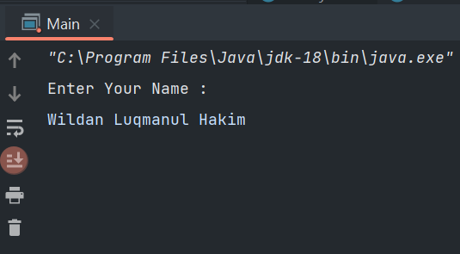
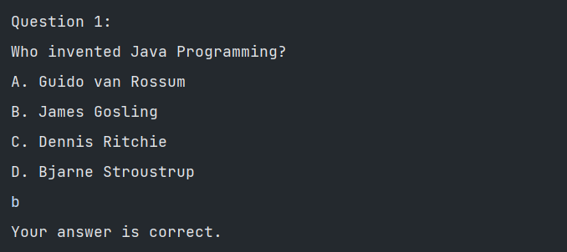
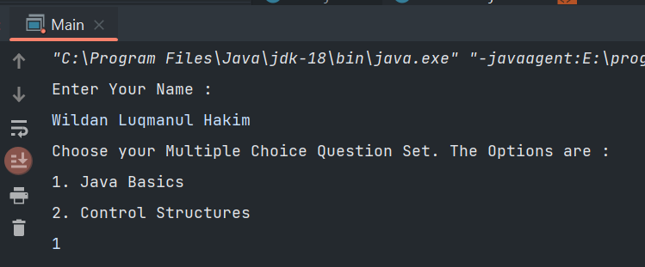
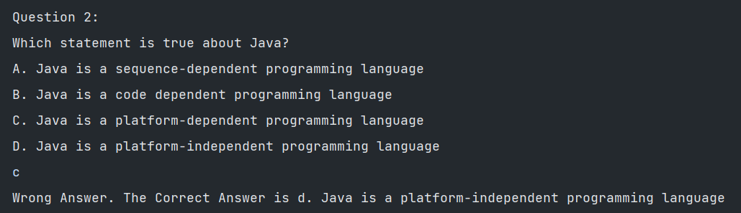
12. Project Results
Screen Shots of Evidences
Input Name User
If Answer Right
Choose MCQ
If Answer Wrong

Slide 16
12. Project Results
Screen Shots of Evidences
Score MCQ

Slide 17
13. Proposed Improvements
List of Improvements
Display a message if the answer in MCQ is right
Display a message if the answer in MCQ is wrong
Calculation for score if user have filled MCQ

